Slide 1
The Binomial Test
Chapter 18

Slide 2
The Binomial Test
A binomial test uses sample data to evaluate hypotheses about the values of p and q for a population consisting of binomial data.
Binomial data exist when the measurement procedure classifies individuals into exactly two distinct categories.
Traditionally, the two categories are identified as A and B, and the population proportions are identified as p(A) = p and p(B) = q.

Slide 3
Hypotheses for the Binomial Test
In the binomial test, the null hypothesis specifies exact values for the population proportions p and q.
Theoretically, you could choose any proportions for H0, but usually there is a clear reason for the values that are selected.

Slide 4
Hypotheses for the Binomial Test (cont’d.)
The null hypothesis typically falls into one of the following two categories.
Often the null hypothesis states that the two outcomes A and B occur in the population with the proportions that would be predicted simply by chance.
You may know the proportions for one population and want to determine whether the same proportions apply to a different population. In this case, the null hypothesis would simply specify that there is no difference between the two populations.

Slide 5
The Data and Test Statistic for the Binomial Test
For the binomial test, a sample of n individuals is obtained and you simply count how many are classified in category A and how many are classified in category B.
When the values pn and qn are both equal to or greater than 10, the binomial distribution approximates a normal distribution.
This allows us to compute z-scores and use the unit normal table to answer probability questions about binomial events.

Slide 6
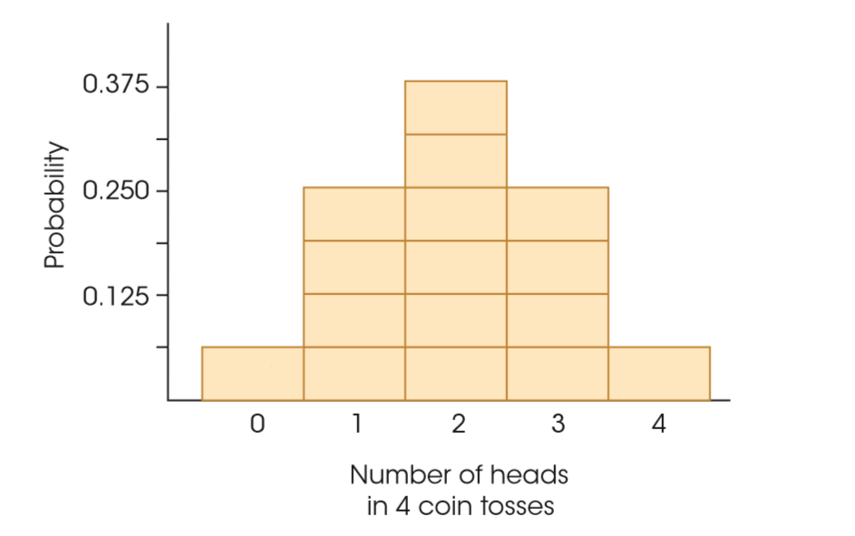
A Binomial Distribution
Notes:
Figure 18.1
A binomial distribution for the number of heads obtained in four tosses of a balanced coin.

Slide 7
The Data and Test Statistic for the Binomial Test (cont’d.)
In particular, when pn and qn are both at least 10, the binomial distribution will have the following properties.
The shape of the distribution is approximately normal.
The mean of the distribution is:
µ = pn
The standard deviation of the distribution is:
σ = √npq

Slide 8
The Data and Test Statistic for the Binomial Test (cont’d.)
In this case, the basic z-score formula can be modified to make it more compatible with the logic of the binomial hypothesis test.
X/n - p
z = ─────
√pq/n
X/n is the proportion of individuals in the sample who are classified in category A.
p is the hypothesized value for the proportion of individuals in the population in category A.
√pq/n is the standard error for the sampling distribution of X/n.

Slide 9
The Logic of the Binomial Test
The logic underlying the binomial test is identical to the logic for the original z‑score test or the t‑statistic hypothesis tests.
The test statistic compares the sample data with the hypothesized value for the population.
If the data are consistent with the hypothesis, we conclude that the hypothesis is reasonable.
However, if there is a large discrepancy between the data and the hypothesis, we reject the hypothesis.

Slide 10
Conducting the Binomial Test
The binomial test follows the same four-step procedure for hypothesis testing:
State the hypotheses. (Note: The null hypothesis specifies values for population proportions p and q)
Locate the critical region. (Note: When both pn and qn are at least 10, then the z-scores form an approximately normal distribution)
Calculate the test statistic (z-score).
Make a decision. (Either "reject" or "fail to reject" the null hypothesis.)

Slide 11
Conducting the Binomial Test (cont'd.)
The binomial distribution forms a discrete histogram, whereas the normal distribution is a continuous curve.
When conducting a hypothesis test with the binomial distribution, the question is whether a specific score is located in the critical region.
If the z-score is only slightly into the critical region, both real limits for X should be checked to ensure that the entire score is beyond the critical boundary.

Slide 12
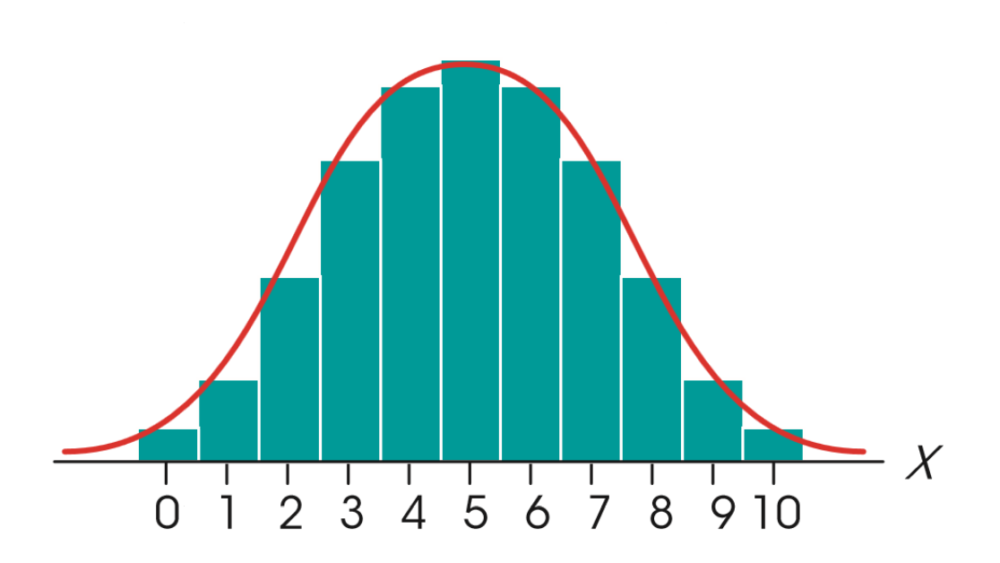
The Relationship between the Binomial Distribution and the Normal Distribution
Notes:
Figure 18.2
The relationship between the binomial distribution and the normal distribution. The binomial distribution is always a discrete histogram, and the normal distribution is a continuous, smooth curve. Each X value is represented by a bar in the histogram or a section of the normal distribution.

Slide 13
The Relationship Between Chi Square and The Binomial Test
Both the binomial test and the chi-square test for goodness of fit evaluate how well the sample proportions fit a hypothesis about the population proportions.
Therefore, when an experiment produces binomial data, these two tests are equivalent and either may be used.

Slide 14
The Sign Test
The sign test is a special application of the binomial test used to evaluate the results from a repeated-measures research design comparing two treatment conditions.
The difference score for each individual is classified as either an increase (+) or a decrease (–) and the binomial test evaluates a null hypothesis stating that increases and decreases are equally likely: p(+) = p(–) = 1/2.

Slide 15
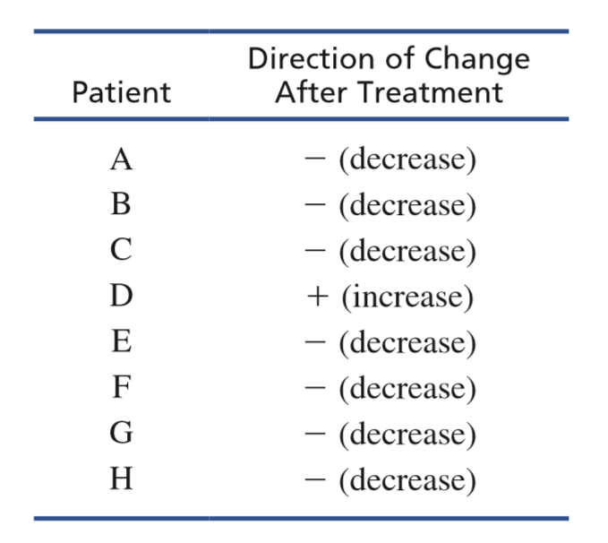
A Hypothetical Data Set
Notes:
Table 18.1
Hypothetical data from a research study evaluating the effectiveness of a clinical therapy. For each patient, symptoms are assessed before and after treatment and the data record whether there is an increase or a decrease in symptoms following therapy.

Slide 16
The Sign Test (cont'd.)
The null hypothesis in the sign test states that if there is any change in an individual’s score, then the probability of an increase is equal to the probability of a decrease.
Stated in this form, the null hypothesis does not consider individuals who show zero difference between the two treatments.
As a result, the usual recommendation is that these individuals should be discarded from the data and the value of n be reduced accordingly.

Slide 17
The Sign Test (cont'd.)
However, if the null hypothesis is interpreted more generally, it states that there is no difference between the two treatments.
Individuals who show no difference actually are supporting the null hypothesis and should not be discarded.
An alternative approach to the sign test is to divide individuals who show zero differences equally between the positive and negative categories.
This alternative results in a more conservative test.

Slide 18
The Sign Test (cont'd.)
In many cases, data from repeated-measures experiment can be evaluated using either a sign test or a repeated-measures t test.
The t test is a more powerful test and should be used whenever possible.

Slide 19
The Sign Test (cont'd.)
The sign test can be valuable in situations where the t test cannot or should not be used.
When you have infinite or undetermined scores
When relying on descriptions that do not involve precise measurement
As a preliminary check on an experiment before serious statistical analysis begins
When there is a very large variance for the difference scores

